Slide 1
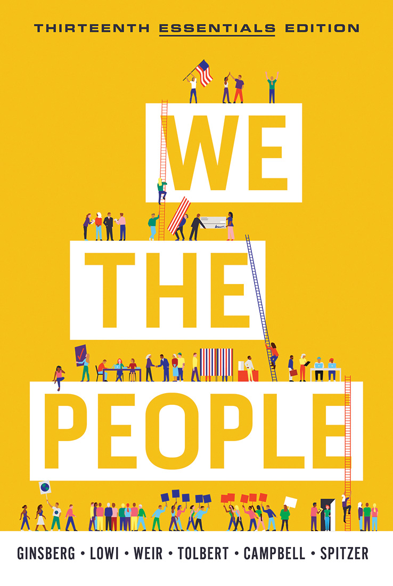
CHAPTER 14
Domestic Policy

Slide 2
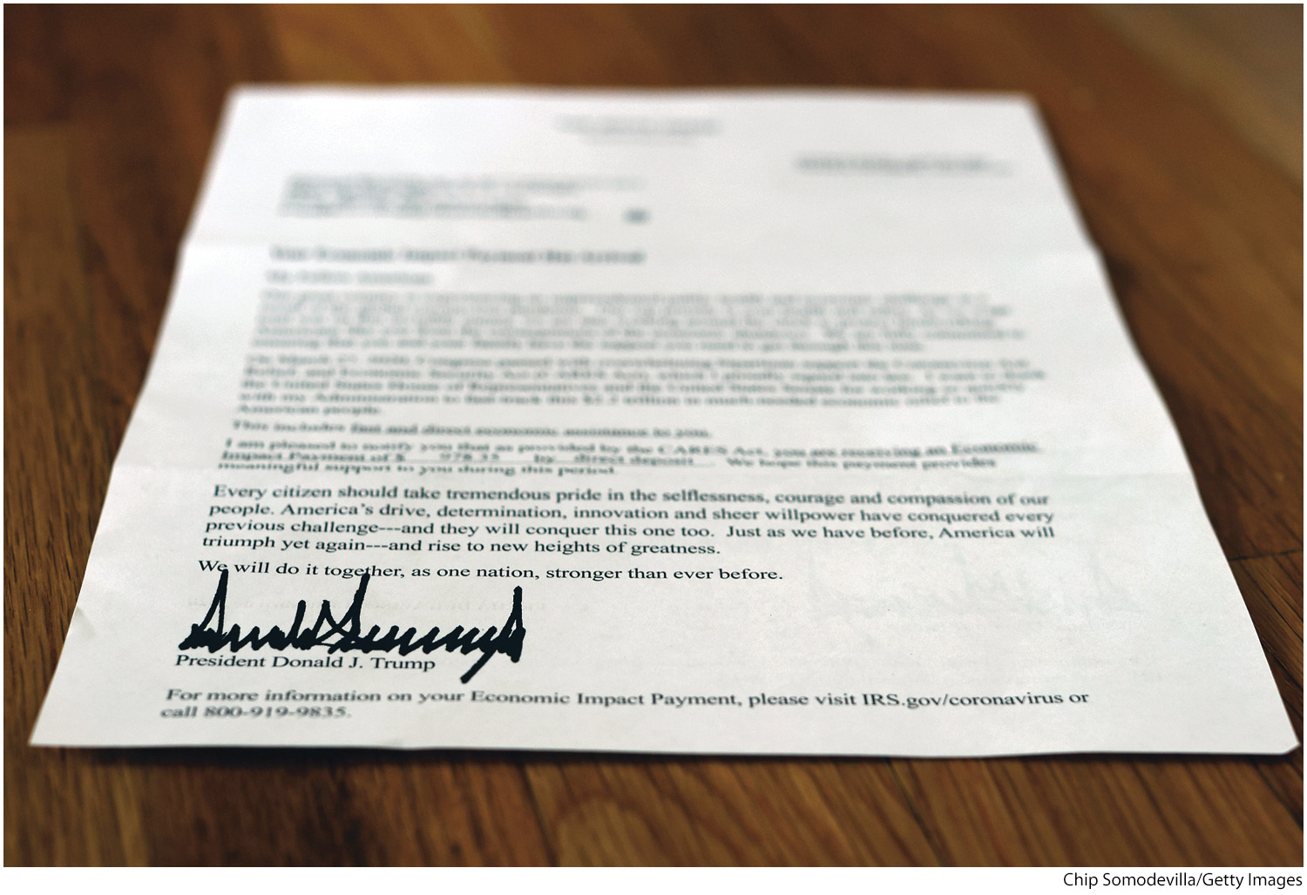
Domestic Policy
Notes:
During the coronavirus pandemic, Congress and the president authorized aid to be distributed to citizens in the form of direct stimulus payments, expanded unemployment insurance, and others. The aid was designed to help both the economy and the welfare of Americans who had lost income due to the pandemic.
[Chip Somodevilla/Getty Images]

Slide 3
Fiscal Policy
Fiscal policy: the government’s use of taxing, monetary, and spending powers to manipulate the economy
Fiscal policy is used to counteract the business cycle.
The government might use it to stimulate the economy.
Or to counter inflation

Slide 4
Fiscal Policy: Taxation
In the 1800s, much of government revenue came from tariffs, or taxes on imported goods.
Today it comes from other taxes, especially the income tax.
The income tax system is progressive (the rate of taxation hits upper income brackets more heavily). This contrasts with more regressive taxes, like the Social Security tax, that burden lower-income brackets more heavily.
The purpose of a progressive income tax is to raise revenue and reduce disparities in wealth (redistribution).
It rewards investment by allowing deductions of business expenditures from taxes.
Notes:
It can be useful to have students come up with a variety of ways that the government raises money, and then you can discuss which taxes are progressive and which are regressive.

Slide 5
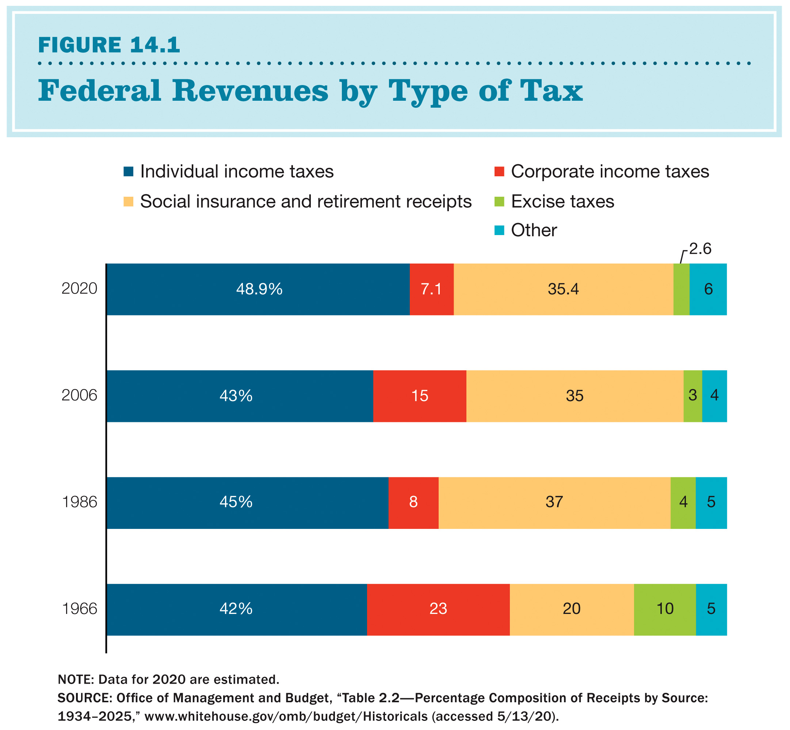
Federal Revenues by Type of Tax
Notes:
Figure 14.1: Federal Revenue by Tax Type
The federal government collects revenue from a variety of different taxes. Most important is the individual income tax, which has grown over the last 50 years, now accounting for approximately 50 percent of federal revenue. Revenues from corporate income tax
have fallen considerably over this time period, from 23 percent in 1966 to 7 percent in 2020. In the same period, taxes for social insurance and retirement have grown substantially. Does the federal government draw more of its revenue from progressive taxes or
regressive taxes?
NOTE: Data for 2020 are estimated.
SOURCE: Office of Management and Budget, “Table 2.2—Percentage Composition of Receipts by Source:1934–2025,” www.whitehouse.gov/omb/budget/Historicals (accessed 5/13/20).

Slide 6
Fiscal Policy: Spending and Budgeting, Part 1
Every year, the government must set a budget. Most years of late, the government has run a budget deficit.
Over time, that budget deficit adds to the national debt.
The government often uses subsidies, which are government grants of cash or commodities, to support certain economic sectors.

Slide 7
Fiscal Policy: Spending and Budgeting, Part 2
Contracting power allows the government to set conditions on companies selling goods or services to government agencies.
Both Congress and the President are involved in budgeting, with the Office of Management and Budget (OMB) and Congressional Budget Office (CBO) playing key roles.

Slide 8
Monetary Policy
Monetary policies are efforts to regulate the economy through the manipulation of the supply of money and credit.
America’s most powerful institution in this area of monetary policy is the Federal Reserve Board, which sits atop the Federal Reserve System.
The Federal Reserve System is a system of 12 Federal Reserve banks that facilitates exchanges of cash, checks, and credit; regulates member banks; and uses monetary policies to fight inflation and deflation.
Every national bank must be a member of this system and follow national banking rules.
The Federal Reserve Board (“the Fed”) comprises seven members appointed by the president.
Members must be confirmed by the Senate.
The Fed is responsible for ensuring high employment and price stability.

Slide 9
The Federal Reserve System Explained
The Federal Reserve System is a system of 12 Federal Reserve banks that facilitates exchanges of cash, checks, and credit; regulates member banks; and uses monetary policies to fight inflation and deflation.
Every national bank must be a member of this system and follow national banking rules.
The Federal Reserve Board (“the Fed”) comprises seven members appointed by the president.
Members must be confirmed by the Senate.
The Fed is responsible for ensuring high employment and price stability.

Slide 10
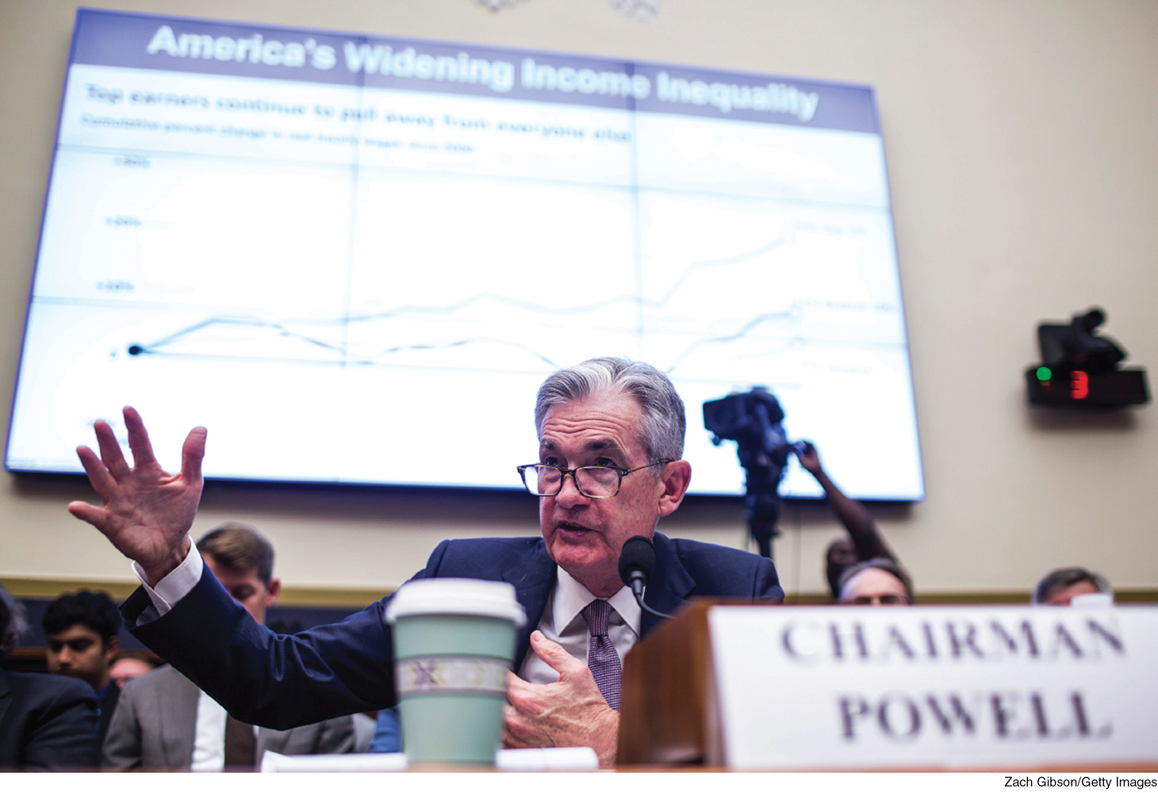
Chair of The Federal Reserve: Jerome Powell
Notes:
Financial markets closely watch the statements of the Federal Reserve. Here, Fed Chair Jerome Powell speaks about widening income inequality in the United States.
[Zach Gibson/Getty Images]

Slide 11
Regulation and Antitrust Policy
The government is also involved in regulation and antitrust policy.
Antitrust policy is specifically the government’s efforts to regulate large businesses that have established monopolies in some market.
A monopoly is a single firm in a market that controls all the goods and services of that market, leading to an absence of competition.
Economic regulation increased in the twentieth century, although deregulation gained popularity in the 1980s and 1990s, especially among the Republican presidents of the decade.

Slide 12
Should the Government Intervene in the Economy?
Until 1929, most Americans believed government should do little in managing the economy. The country was guided by laissez-faire capitalism.
The Great Depression altered public opinion.
Franklin D. Roosevelt (FDR) was elected president in 1932 and he supported action from the federal government to combat the Great Depression.

Slide 13
Should the Government Intervene in the Economy? Keynes
Keynesian economics is named after John Maynard Keynes.
Keynesians argue that government can stimulate the economy by increasing public spending or cutting taxes.
The government stimulates demand; this creates increased production, which pulls the economy out of recession.

Slide 14
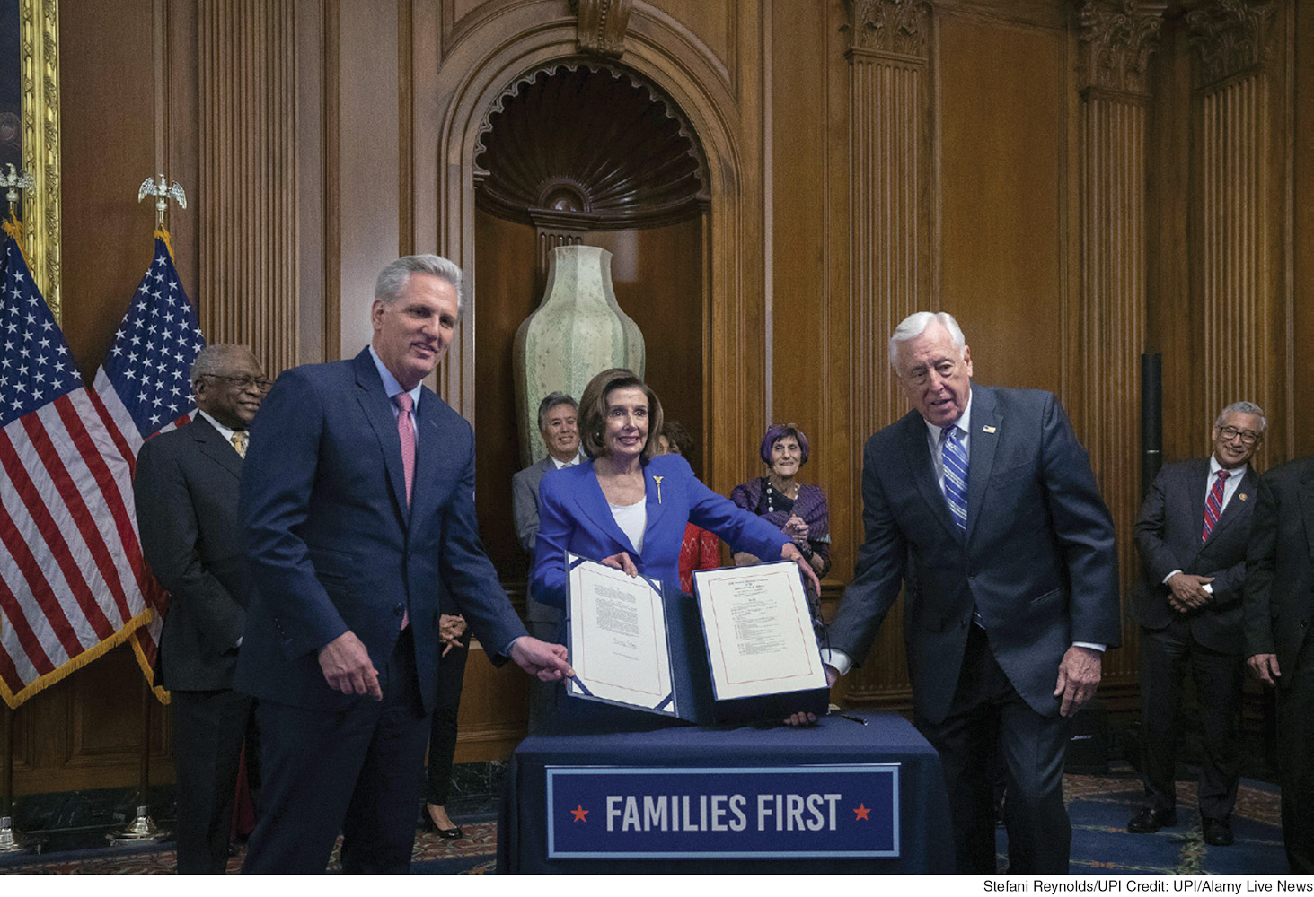
CARES Act Funding
Notes:
In response to the economic catastrophe caused by the coronavirus pandemic, Congress passed and the president signed the Families First and CARES acts to provide cash payments to individuals, assistance to businesses, and expanded unemployment benefits.
[Stefani Reynolds/UPI/Alamy Live News]

Slide 15
Should the Government Intervene in the Economy? Other Philosophies
A growing number of Republicans began to reject Keynesian philosophy in the 1980s.
They argued that to produce the best economic results, markets should be free from government intervention.
Supply-side economics and a desire to lower taxes became core components of the Republican Party’s policies.
However, Democrats continued to believe in government’s role in the economy and in the value of government spending.
Notes:
Supply-side economics: an economic theory that posits that reducing the marginal rate of taxation will create a productive economy by promoting levels of work and investment that would otherwise be discouraged by higher taxes

Slide 16
Spending and Regulation
The parties have long battled over government spending.
Republicans argue the government is too big and that spending is excessive. Democrats argue that the government helps provide important support to citizens.
Regulations follows a similar pattern, with Democrats more in favor of government regulation of business than Republicans.
Spending cuts poll well, until people are asked about specific expensive (and usually popular) programs. Because neither party wishes to cut these programs, and because tax increases have been difficult to enact, budget deficits continue to grow.

Slide 17
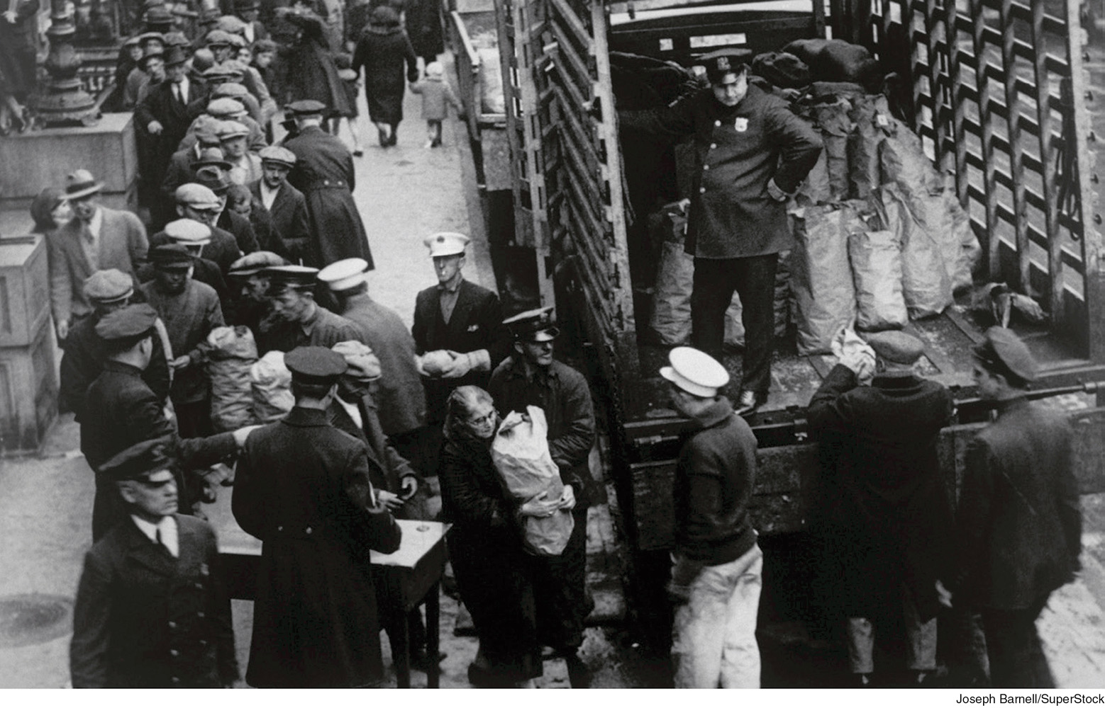
Foundation of the Welfare State
Welfare State: the collection of policies a nation has to promote and protect the economic and social well-being of its citizens
Notes:
During the Great Depression, the government took a more active role in helping poor and struggling Americans. Here, people line up to receive free bread.
[Joseph Barnell/SuperStock]

Slide 18
The Modern Welfare System: Contributory Programs
One category of welfare programs can be thought of as “mandatory savings.”
Contributory programs: social programs financed in whole or in part by taxation or other mandatory contributions by their present or future recipients
Social Security: a contributory welfare program into which working Americans contribute a portion of their wages and from which they receive cash benefits after retirement or if they become disabled
Medicare: a form of national health insurance for the elderly and disabled
Unemployment insurance: helps replace lost wages but at a low level

Slide 19
The Modern Welfare System: Contributory Programs, Part 2
Social Security benefits and costs are adjusted by indexing.
Indexing: a periodic process of adjusting social benefits or wages to account for increases in the cost of living
Such modifications are based on cost-of-living adjustments (COLAs).
COLAs: changes made to the level of benefits of a government program based on the rate of inflation

Slide 20
The Modern Welfare System: Noncontributory Programs
Noncontributory programs are also known as “social assistance programs.”
Noncontributory programs are social programs that provide assistance to people on the basis of demonstrated need rather than any contribution they have made.
Programs in this category are widely called “welfare.”
Potential beneficiaries must demonstrate their need via means testing.

Slide 21
The Modern Welfare System: Medicaid
Medicaid is a federally and state-financed, state-operated program providing medical services to low-income people.
Established in 1965, it is the largest single expansion of noncontributory assistance in American history.

Slide 22
The Modern Welfare System: Other Noncontributory Programs
Supplemental Security Income (SSI) provides uniform minimum benefits for elderly, blind, and disabled people.
Temporary Aid to Needy Families (TANF) provides assistance to families with children.
Benefits vary widely from one state to the next.
Supplemental Nutrition Assistance Program (SNAP) is the largest antipoverty program, which provides recipients with a debit card for food at most grocery stores; formerly known as food stamps.
Collectively these programs provide what are called in-kind benefits (noncash goods and services provided to needy individuals and families).
Notes:
TANF is pronounced “tan-iff.” This is the program to which the term welfare refers and, as the textbook notes, it took the place of Aid to Families with Dependent Children (AFDC). AFDC and TANF have generally been unpopular among voters, elected officials, and those who do not receive it.
The 1996 welfare reform changes included a five-year lifetime limit (not more than two years at a time), a work or education/training requirement for adults, and less cash assistance (over 70 percent of TANF funds are not cash or direct payments to recipients). It is worth noting that Medicaid payments to health care providers are lower than what they would receive from other insurers. This is important because doctors and hospitals do not have to take Medicaid patients, and if they can earn more money from taking in other patients, they often do so instead.

Slide 23
Equality of Opportunity
Part of the purpose of the welfare state is to try to provide equality of opportunity to Americans.
The key policies for doing so are:
education policies
health policies
housing policies
Notes:
Equality of opportunity: a widely shared American ideal that all people should have the freedom to use whatever talents and wealth they have to reach their fullest potential

Slide 24
The Modern Welfare System: Tax Expenditures
The United States also provides social welfare benefits through tax breaks.
Tax expenditures are credits, deductions, and preferential tax rates that subsidize social welfare.
This includes employer-funded health insurance and retirement plans.
Homeowners can deduct home mortgage interest.
These breaks mainly benefit middle- and upper-income people.

Slide 25
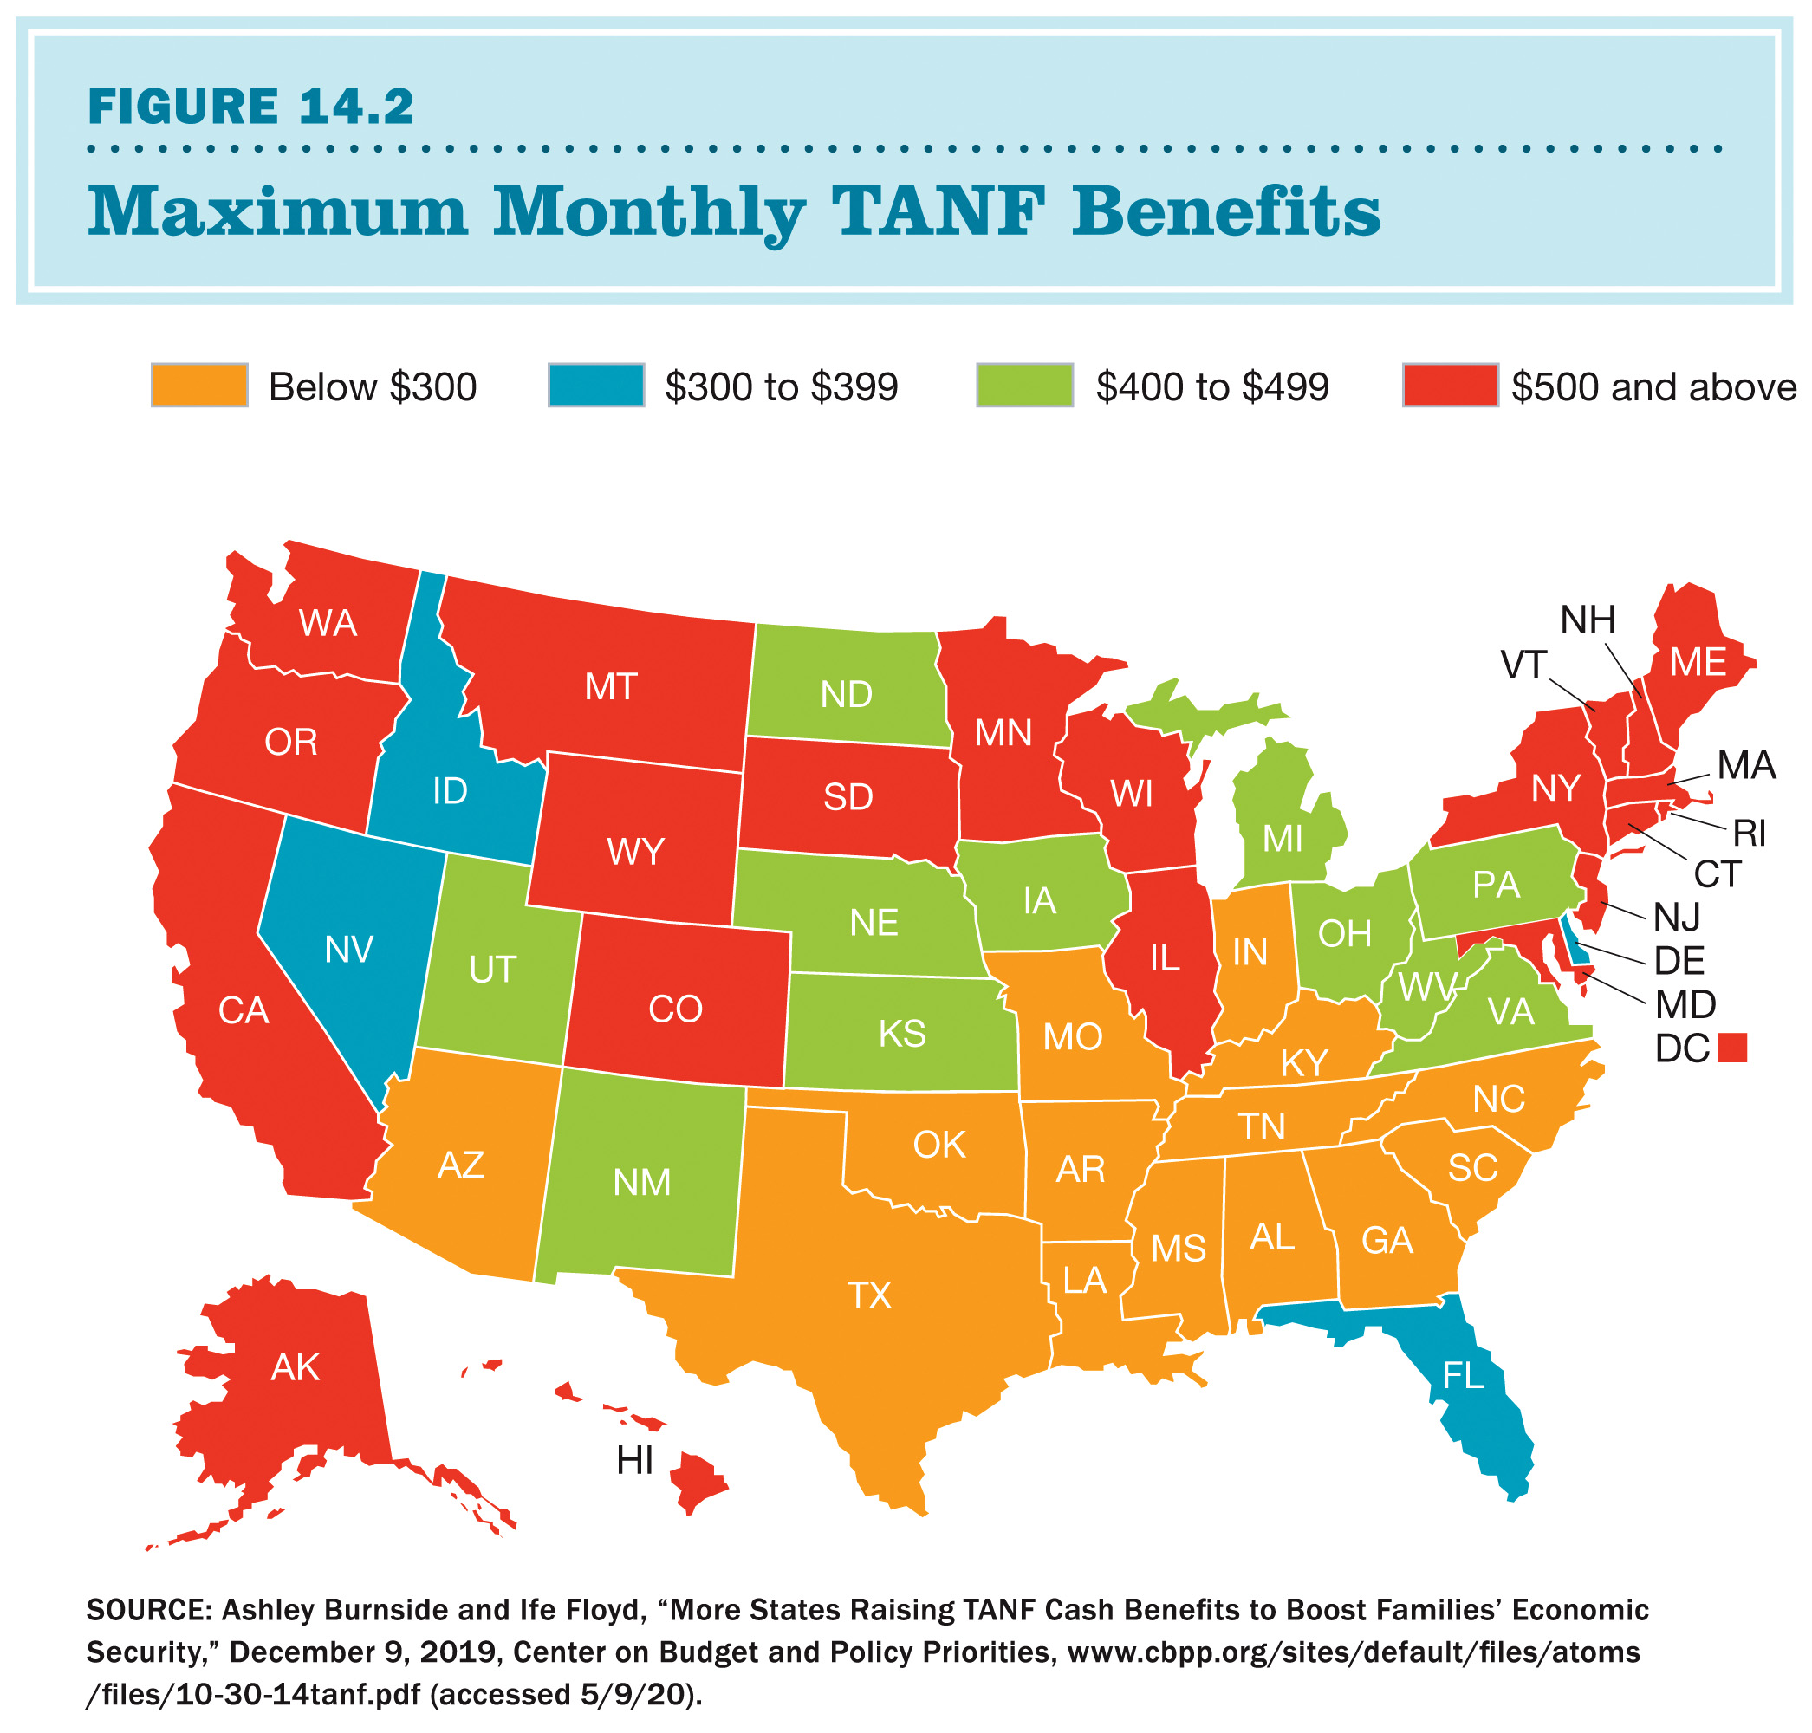
The Modern Welfare State: TANF Spending
Notes:
FIGURE 14.2 Monthly Spending on TANF Benefits
Spending on TANF benefits varies widely across the country. In 14 states, monthly benefits for a family of three are below $300 a month; in 21 states and Washington D.C., they are above $500. In which regions does spending on TANF benefits tend to be higher? In which regions is it generally lower?
SOURCE: Ashley Burnside and Ife Floyd, “More States Raising TANF Cash Benefits to Boost Families’ Economic Security,” December 9, 2019, Center on Budget and Policy Priorities, www.cbpp.org/sites/default/files/atoms/files/10-30-14tanf.pdf (accessed 5/9/20).

Slide 26
Education Policy
Education policies are the single most important force in the distribution and redistribution of opportunity.
Education is handled mostly by the state and local governments, but the federal government began to take a larger role in education policy after World War II.
GI Bill of Rights of 1944
National Defense Education Act of 1958
Elementary and Secondary Education Act of 1965

Slide 27
Education Policy in Recent Years
2001’s No Child Left Behind (NCLB) Act marked a major shift in federal involvement in K–12 education policy:
combined the goals of higher standards and equality of opportunity
aimed to improve standards through stronger federal requirements for student testing and school accountability
ultimately generated significant controversy and was criticized by teachers and states

Slide 28
Education Policy Under President Obama
During President Obama’s tenure, education was once again decentralized toward the states:
Waivers for the No Child Left Behind Act came with conditions.
A bipartisan bill, the Every Student Succeeds Act, ultimately replaced NCLB.
The Obama administration was a strong proponent of charter schools, which are publicly funded schools that are free from many of the rules and regulations of the school district in which they’re located.
Support for charter schools continued under President Trump.

Slide 29
Higher Education Policy
Most higher education has historically been funded by the states, but federal programs have made a big difference in promoting equal access to higher education.
The GI Bill of 1944 put higher education in reach of a whole generation of World War II veterans.
In 1972 Congress created the Pell Grant program, which offers grants directly to lower-income students.
However, states have sharply reduced funding for higher education since the mid-1970s, and Pell Grants have not increased to match inflation, thus the growing costs of higher education once again threatens to put college out of reach for many lower-income students.

Slide 30
Health Policies
The federal government is also involved in health policy.
The U.S. Public Health Service has been in existence since 1798, but it played only a small part in public health policy until the mid-1900s.
headed by the U.S. surgeon general
includes the National Institutes of Health (NIH) and Centers for Disease Control and Prevention (CDC)

Slide 31
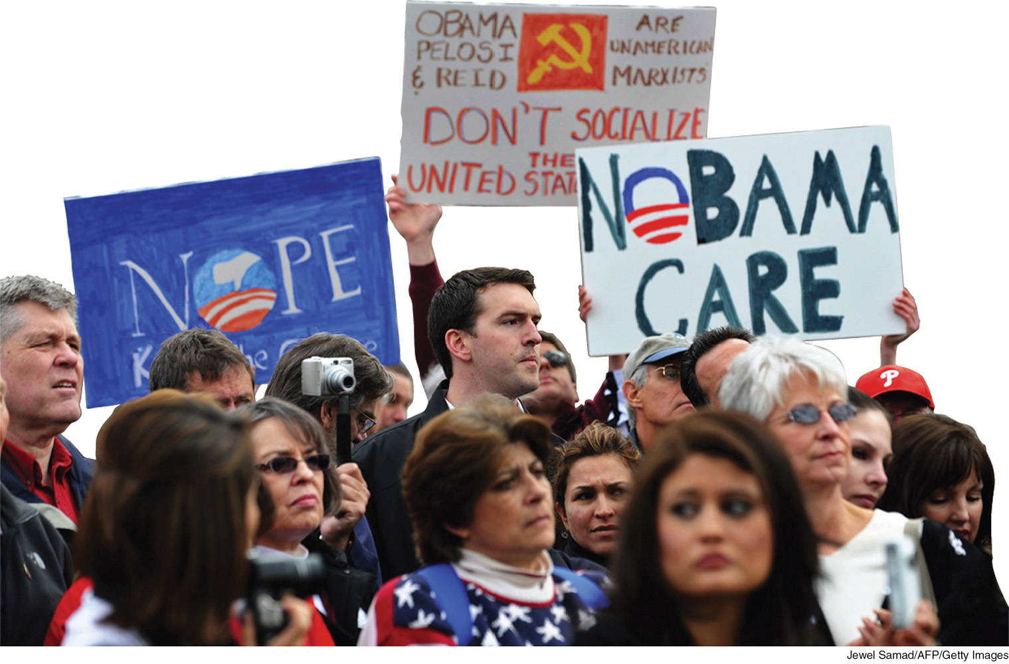
Opposing The Affordable Care Act
Notes:
Some Americans opposed the 2010 Affordable Care Act because they were concerned that decisions previously left to patients and their doctors would be made by the government.
[Jewel Samad/AFP/Getty Images]

Slide 32
Health Policies: The Affordable Care Act
The Affordable Care Act (ACA) was enacted in 2010.
Three key features of the ACA:
creation of new state-based insurance exchanges and regulations prohibiting insurers from denying coverage
individual mandate: required individuals to purchase health insurance or risk paying a fine (this provision was subsequently repealed by Congress)
government subsidies; expansion of Medicaid and the Children’s Health Insurance Program (CHIP)
designed to help the uninsured, small businesses, and low-income people purchase health insurance

Slide 33
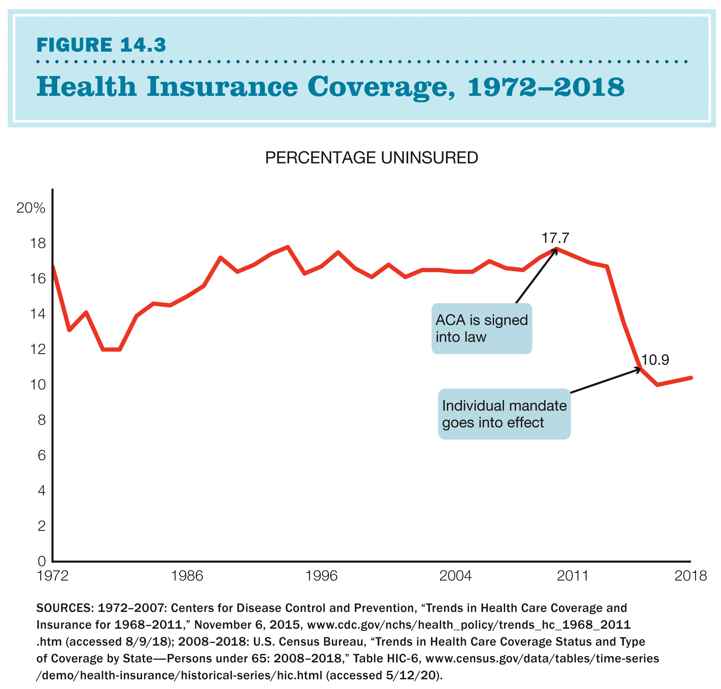
Health Insurance Coverage, 1972-2018
Notes:
Figure 14.3 Health Insurance Coverage, 1972–2018
The percentage of Americans under 65 without health insurance reached 17.7 percent in 2010, when the ACA was enacted. With implementation beginning in 2014, the uninsured rate fell to 10 percent in 2016. It began to rise in 2018 with reductions in the ACA enrollment period and advertising and is predicted to rise further with the repeal of the individual mandate, effective 2019, and with job losses from the coronavirus pandemic.
SOURCES: 1972–2007: Centers for Disease Control and Prevention, “Trends in Health Care Coverage and Insurance for 1968–2011,” November 6, 2015, www.cdc.gov/nchs/health_policy/trends_hc_1968_2011.htm (accessed 8/9/18); 2008–2018: U.S. Census Bureau, “Trends in Health Care Coverage Status and Type of Coverage by State—Persons under 65: 2008–2018,” Table HIC-6, www.census.gov/data/tables/time-series/demo/health-insurance/historical-series/hic.html (accessed 5/12/20).

Slide 34
Housing Policies Promote Stability
Access to quality, affordable housing provides individuals and families with stability.
Specific federal housing policies have evolved.
Public housing projects were replaced in the 1980s with vouchers that provide recipients with support to rent in the private market.
Critics argue that vouchers provide too little money, and only one-quarter of eligible families receive them.
Some federal housing policies had a discriminatory effect, perpetuating residential segregation by race. This includes “redlining” and “restrictive covenants.”
In 2007, a home loan foreclosure crisis destabilized the economy.

Slide 35
Who Gets What from Social Policy?
Beneficiaries of social policy:
the elderly
the middle and upper classes
the working poor
the nonworking poor
minorities, women, and children

Slide 36
Who Gets What from Social Policy? The Elderly
The elderly are the beneficiaries of two generous policies: Social Security and Medicare.
Social Security has dramatically reduced poverty among the elderly since its inception.
It is considered the most effective antipoverty program in the United States.
Both Social Security and Medicare are politically strong.
This is in part because the elderly vote at such high rates and have developed strong lobbying organizations.

Slide 37
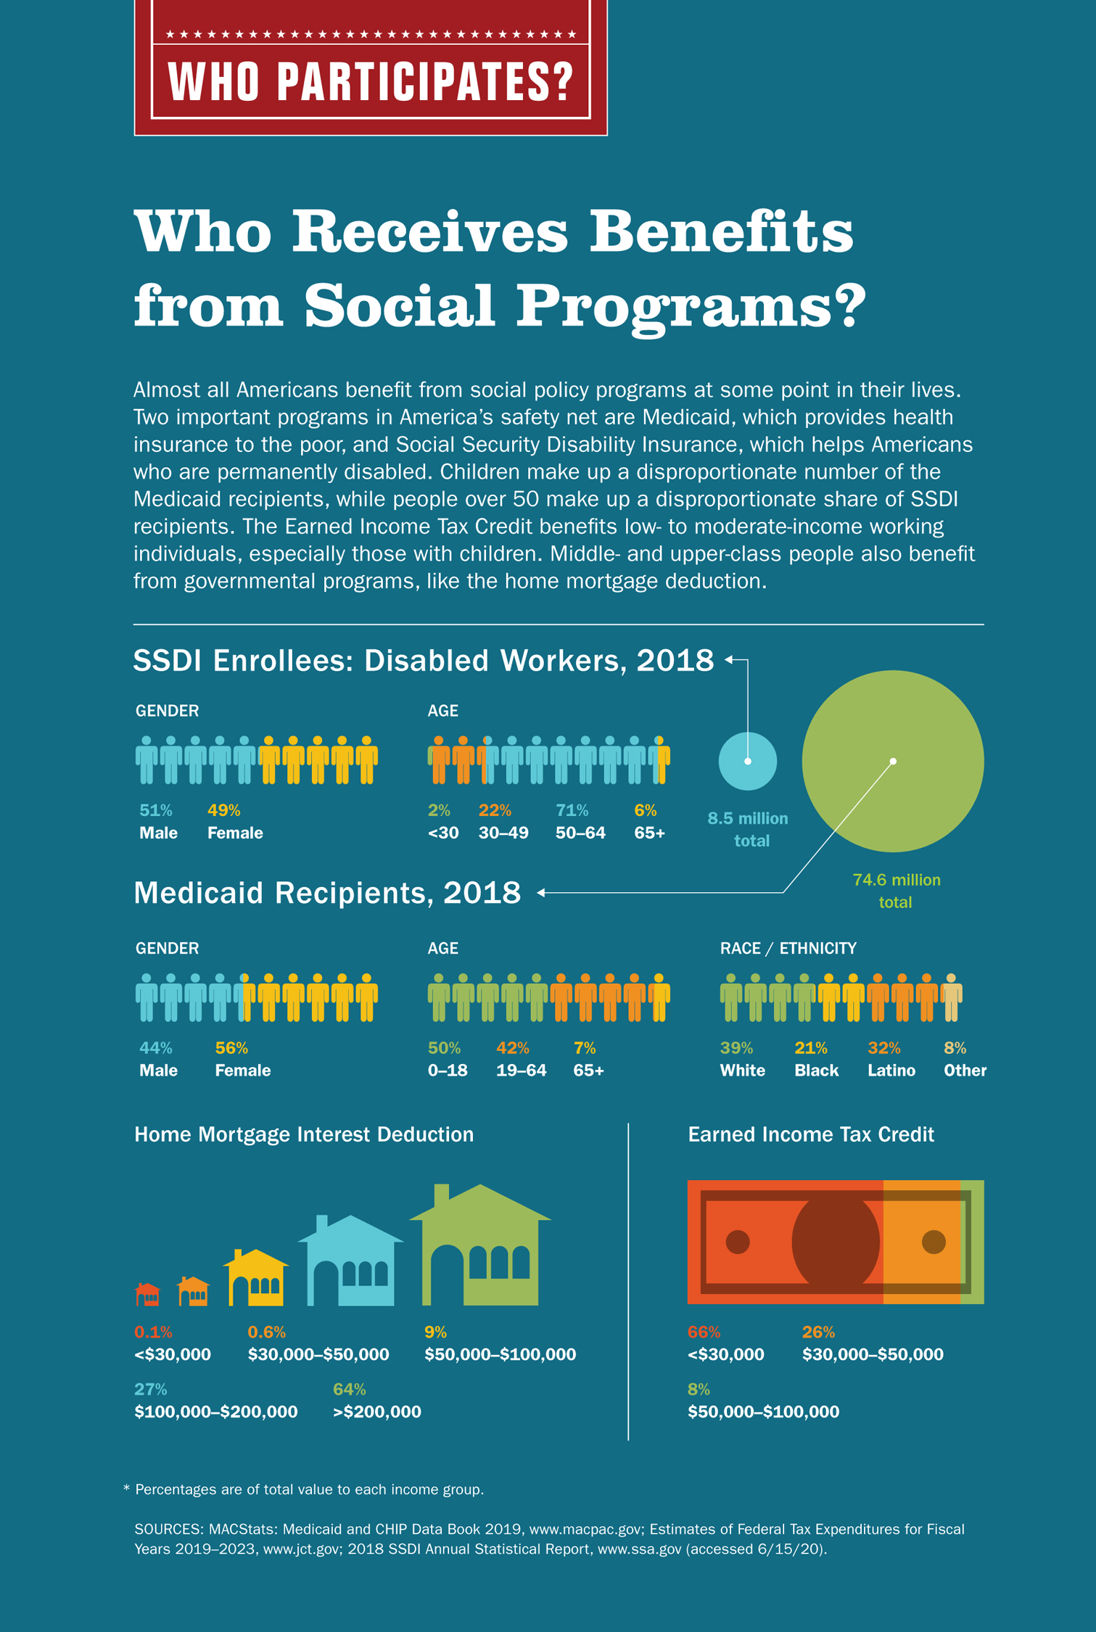
Who Participates?: Who Receives Benefits from Social Programs?
Notes:
Who Receives Benefits from Social Programs?
* Percentages are of total value to each income group.
SOURCES: MACStats: Medicaid and CHIP Data Book 2019, www.macpac.gov; Estimates of Federal Tax Expenditures for Fiscal Years 2019–2023, www.jct.gov; 2018 SSDI Annual Statistical Report, www.ssa.gov (accessed 6/15/20).

Slide 38
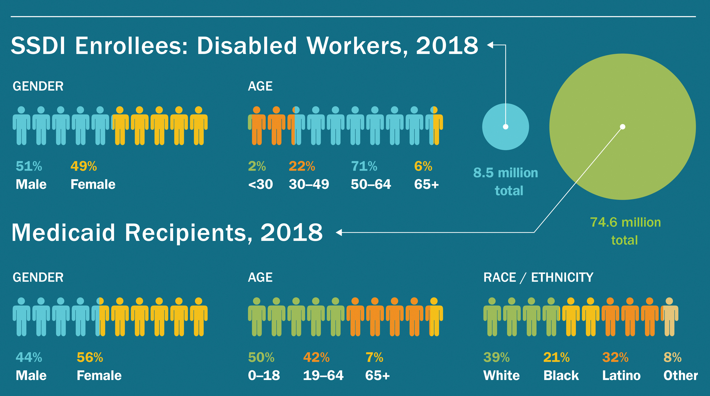
Who Participates?: SSDI Enrollees
Notes:
Who Receives Benefits from Social Programs?
* Percentages are of total value to each income group.
SOURCES: MACStats: Medicaid and CHIP Data Book 2019, www.macpac.gov; Estimates of Federal Tax Expenditures for Fiscal Years 2019–2023, www.jct.gov; 2018 SSDI Annual Statistical Report, www.ssa.gov (accessed 6/15/20).

Slide 39
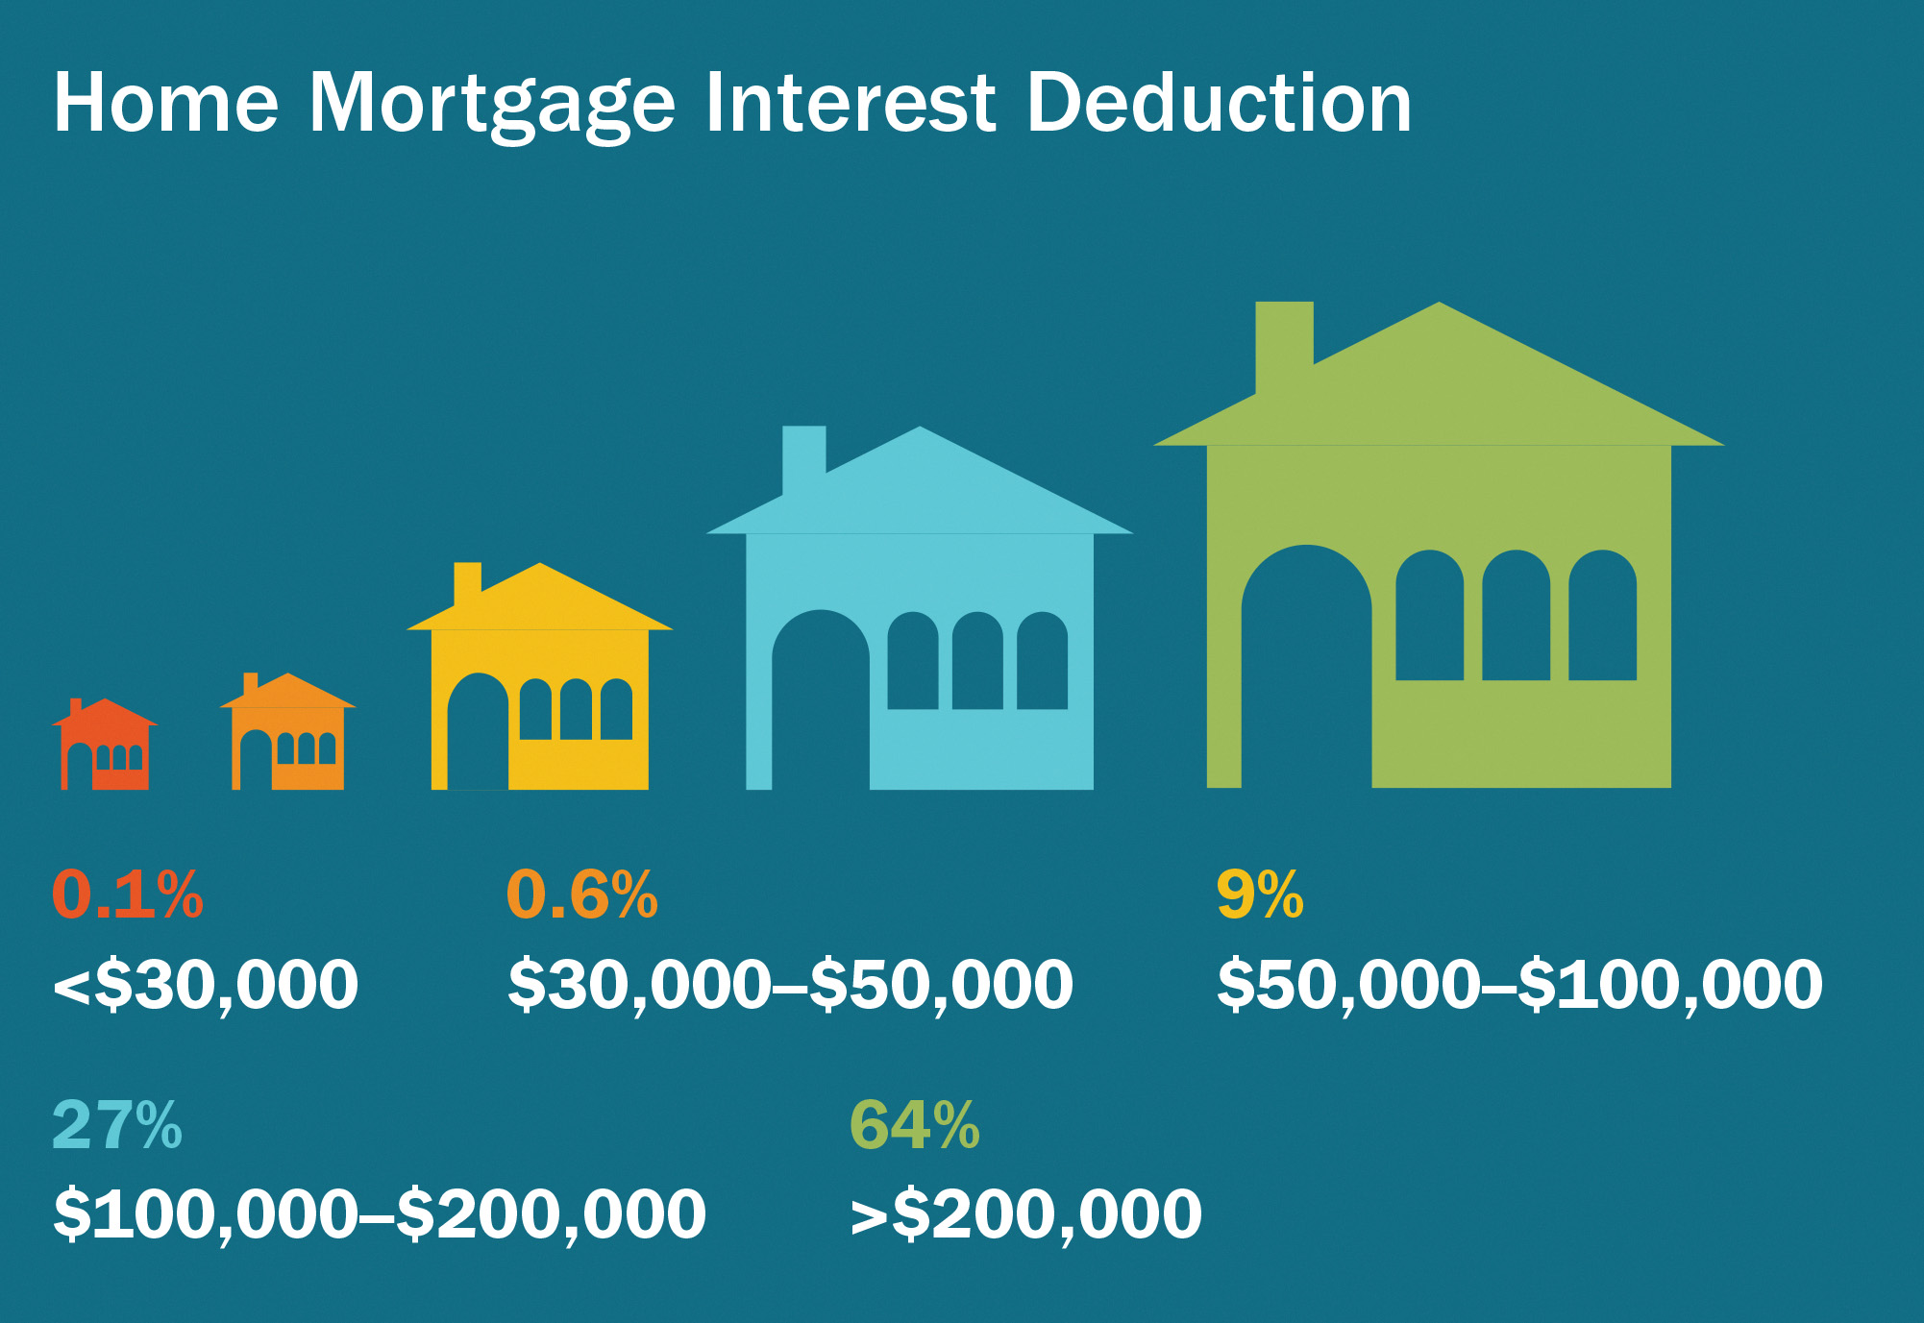
Who Participates?: Home Mortgage Interest Deducation
Notes:
Who Receives Benefits from Social Programs?
* Percentages are of total value to each income group.
SOURCES: MACStats: Medicaid and CHIP Data Book 2019, www.macpac.gov; Estimates of Federal Tax Expenditures for Fiscal Years 2019–2023, www.jct.gov; 2018 SSDI Annual Statistical Report, www.ssa.gov (accessed 6/15/20).

Slide 40
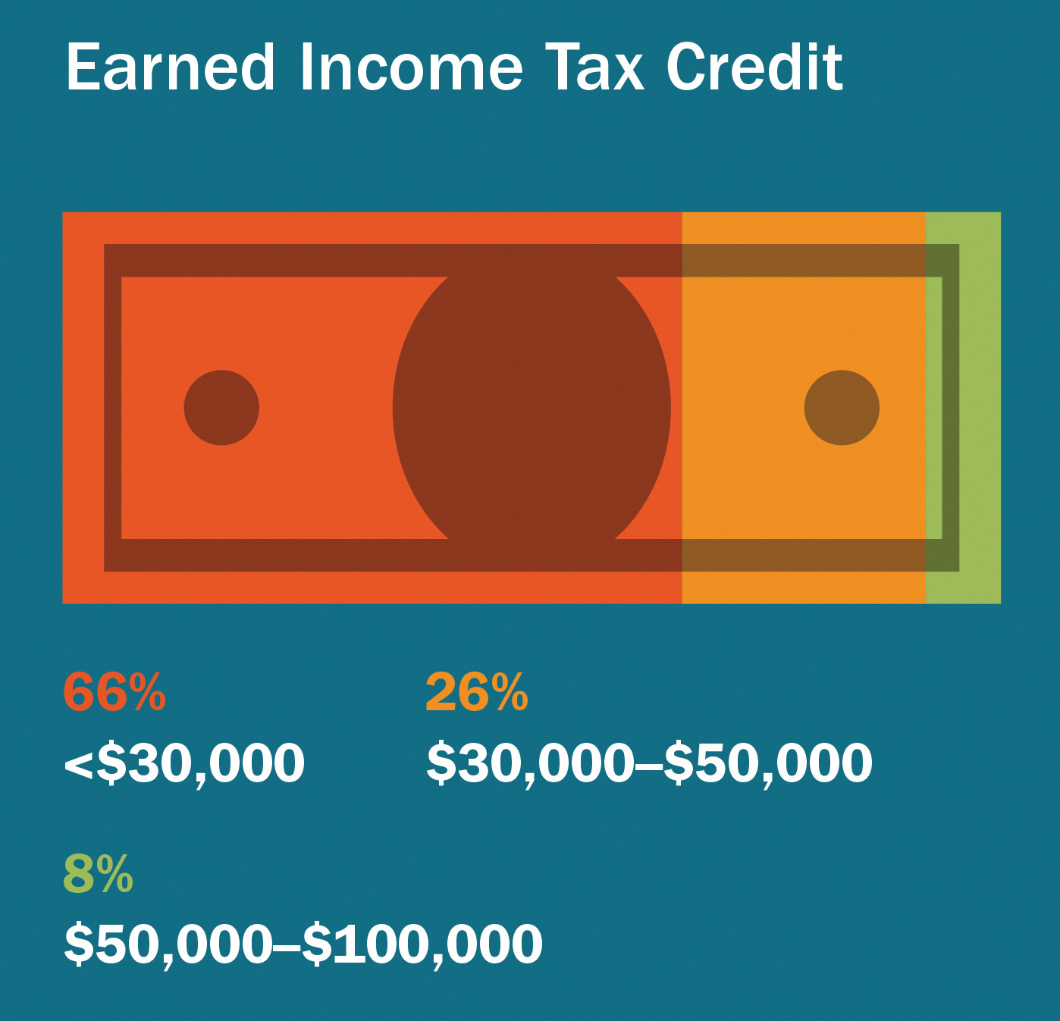
Who Participates?: Earned Income Tax Credit
Notes:
Who Receives Benefits from Social Programs?
* Percentages are of total value to each income group.
SOURCES: MACStats: Medicaid and CHIP Data Book 2019, www.macpac.gov; Estimates of Federal Tax Expenditures for Fiscal Years 2019–2023, www.jct.gov; 2018 SSDI Annual Statistical Report, www.ssa.gov (accessed 6/15/20).

Slide 41
Who Gets What from Social Policy? Economic Classes
The middle and upper classes also benefit from social welfare programs.
Social Security helps the middle class by relieving them of the costs associated with caring for elderly relatives.
The middle class benefits from the “shadow welfare state” of tax expenditures.
The majority of tax expenditure benefits go to middle- and upper-income households.
This includes state and local tax deductions, home mortgage deductions, and charitable contribution deductions.

Slide 42
Who Gets What from Social Policy? Economic Classes, Part 2
The working poor often do not benefit from the shadow welfare state.
They do not hold jobs that offer health insurance or pensions.
They are likely to rent rather than own a home, so they have no mortgage deduction.
The working poor benefit from three major programs.
The Affordable Care Act (ACA): heath insurance subsidies
The Earned Income Tax Credit (EITC): tax relief and a modest wage supplement
The Supplemental Nutrition Assistance Program (SNAP): food assistance

Slide 43

The Supplemental Nutrition Assistance Program
Notes:
The Supplemental Nutrition Assistance Program (SNAP), formerly known as “food stamps,” helps people in need buy food. Today recipients use a government-provided debit card that is accepted at most grocery stores. In 2020, 38 million Americans were enrolled in SNAP.
[Derek Davis/Portland Press Herald via Getty Images]

Slide 44
Who Gets What from Social Policy? The Unemployed
The nonworking poor primarily benefit from the TANF program.
They may also receive benefits from SNAP and Medicaid.
Able-bodied adults who are not caring for children are not eligible for assistance other than food stamps.
Many states offer “general assistance” (cash assistance).

Slide 45
Who Gets What from Social Policy? Race, Age, and Gender
Minorities are disproportionately poor.
The poverty rate for African Americans is 18.8 percent.
The poverty rate for Latinos is 15.7 percent.
The poverty rate for non-Hispanic whites is 7.3 percent.
Women and children are also more likely to be in poverty. Single mothers are twice as likely to be poor as the average American.
The rate of child poverty has increased in recent years.

Slide 46
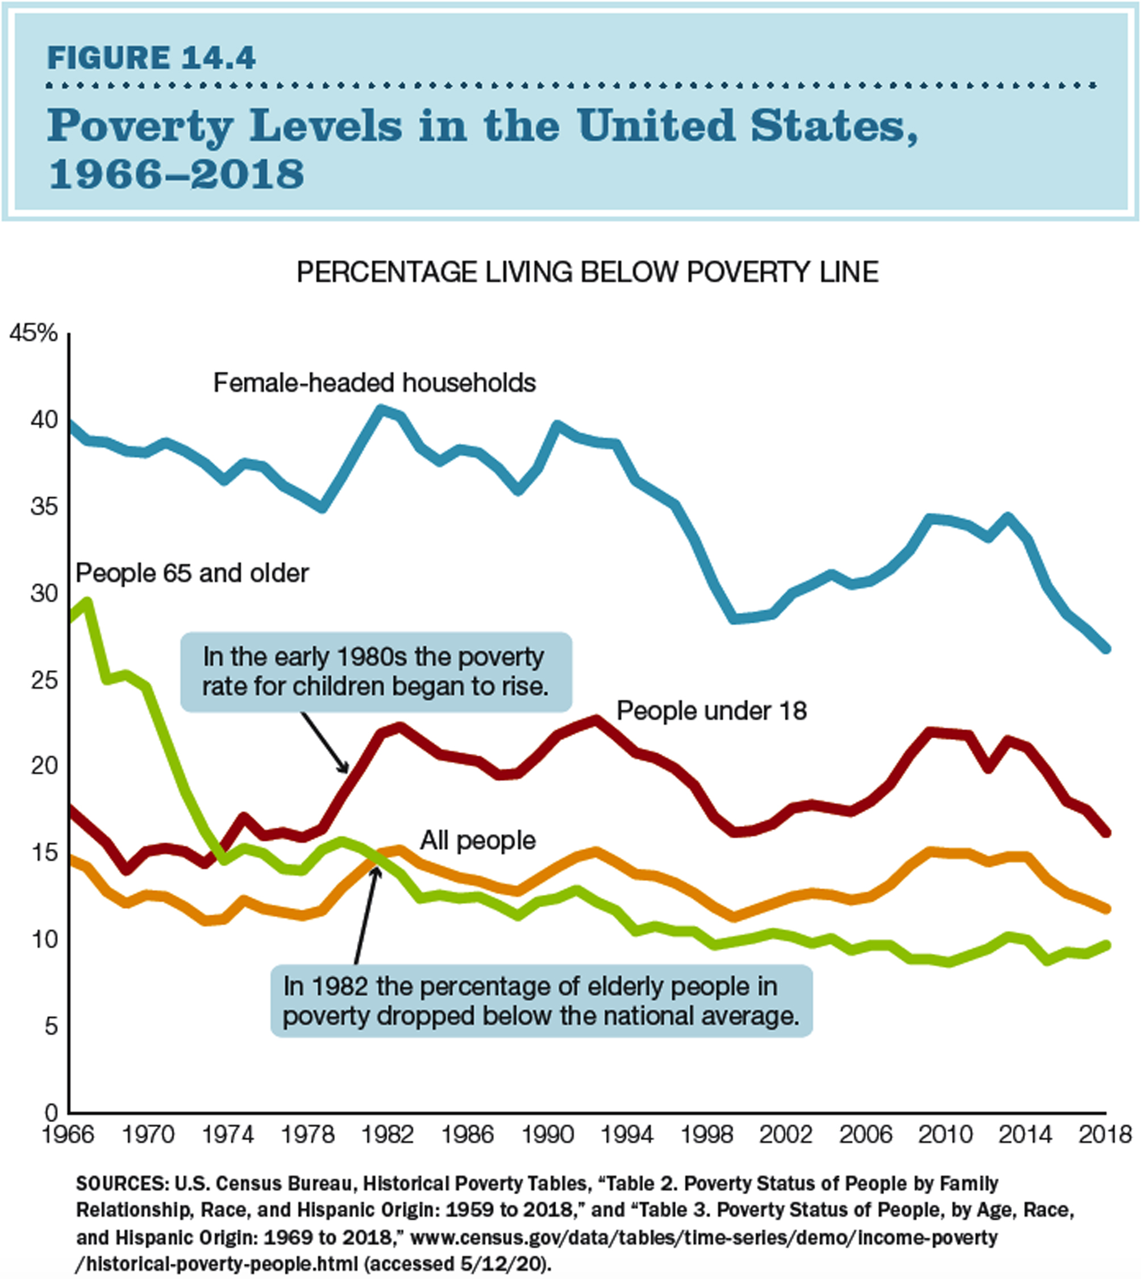
Poverty Levels in the United States
Notes:
Figure 14.4 Poverty Levels in the United States, 1966–2018
Poverty rates in the U.S. population vary considerably. The rate of poverty among female-headed households declined significantly in the 1990s, increased since 2000, and declined again after 2010. Which group has seen the greatest reduction in its poverty level since 1966? How might poverty levels change with the effects of the coronavirus pandemic?
SOURCES: U.S. Census Bureau, Historical Poverty Tables, “Table 2. Poverty Status of People by Family Relationship, Race, and Hispanic Origin: 1959 to 2018,” and “Table 3. Poverty Status of People, by Age, Race, and Hispanic Origin: 1969 to 2018,” www.census.gov/data/tables/time-series/demo/income-poverty/historical-poverty-people.html (accessed 5/12/20).

Slide 47
Public Opinion Poll: Q1
Which of the following do you believe has the greatest impact on the economy of the United States?
U.S. president
U.S. Congress
chair of the Federal Reserve
individual state governments
Notes:
47

Slide 48
Public Opinion Poll: Q2
Do you believe the federal government’s economic policy should include attempts to minimize tax disparities between the lowest and highest earners?
yes
no
Notes:
48

Slide 49
Public Opinion Poll: Q3
Do you believe the federal government should eliminate Social Security and Medicare programs and require individuals to have their own supplemental income and insurance?
Yes, the government should end these programs.
No, the government should keep these programs.
No, the government should make these programs optional.
Notes:
49

Slide 50
Public Opinion Poll: Q4
Should welfare benefits—in terms of programs and direct payments to recipients—be the same in all states?
Yes, all states should address poverty in the same way, using only federal funds and programs.
No, states should be able to address poverty in the manner they think is most appropriate, adding state-level programs and funds if they wish to do so.
Notes:
50

Slide 51
Public Opinion Poll: Q5
Should the federal government spend more to make college education more affordable?
Yes, government should spend more on college education to make it more affordable.
No, government should keep spending as it is, with no increase or decrease.
No, government should cut spending on college education, cutting current levels.
Notes:
51

Slide 52
Additional Information
Following this slide, you will find additional images, figures, and tables from the textbook.
Notes:
52

Slide 53
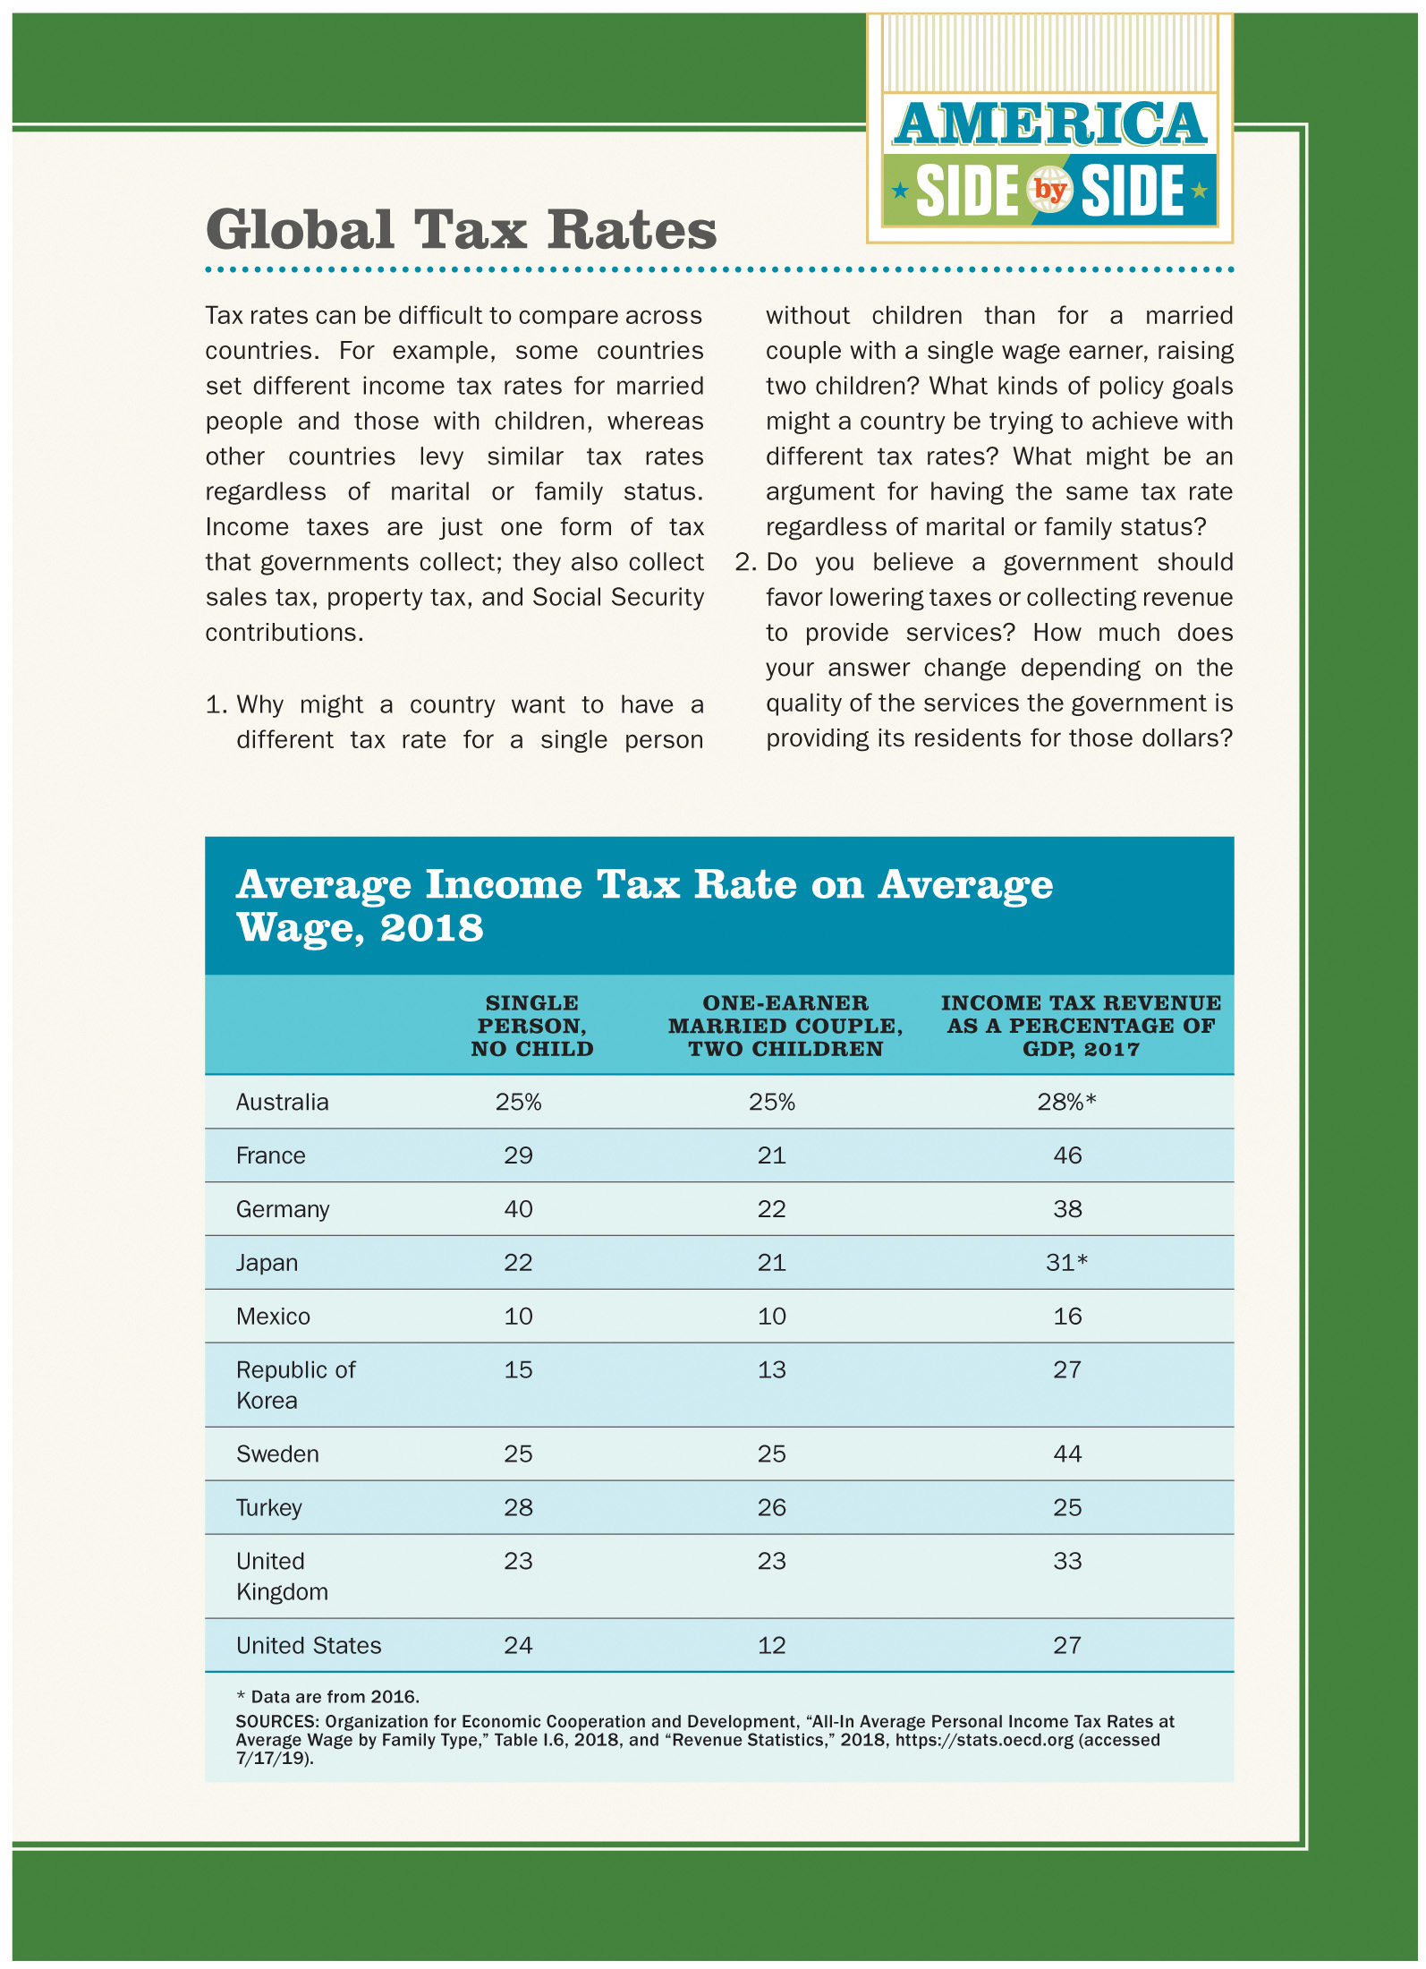
American Side by Side: Global Tax Rates
Country | Single person child | One earner married couple two children | Income Tax revenue as a percentage of G D P, 2017.
Australia | 25 percent | 25 percent | 28 percent, data are from 2016
France | 29 | 21 | 46
Germany | 40 | 22 | 38
Japan | 22 | 21 | 31, data are from 2016
Mexico | 10 | 10 | 16
Republic of Korea | 15 | 13 | 27
Sweden | 25 | 25 | 44
Turkey | 28 | 26 | 25
United Kingdom | 23 | 23 | 33
United States | 24 | 12 | 27
Notes:
Global Tax Rates
* Data are from 2016.
SOURCES: Organization for Economic Cooperation and Development, “All-In Average Personal Income Tax Rates at Average Wage by Family Type,” Table I.6, 2018, and “Revenue Statistics,” 2018, https://stats.oecd.org (accessed 7/17/19).

